Slide 1
크롤링

Slide 2
정적 크롤링(beautifulSoup)

Slide 3
예제1

Slide 4
bs4
import requests
from bs4 import BeautifulSoup
import pandas as pd
from tqdm import tqdm

Slide 5
bs4
url = "https://www.hollys.co.kr/store/korea/korStore2.do"
response = requests.get(url)
html = response.text
soup = BeautifulSoup(html, 'html.parser')
trs = soup.find_all('tr')
ths=trs[0].find_all('th')
region=ths[0].string
name=ths[1].string
address=ths[3].string
tel=ths[5].string

Slide 6
bs4
dflist=[]
for page in tqdm(range(1,53)):
url=f"https://www.hollys.co.kr/store/korea/korStore2.do?pageNo={page}&sido=&gugun=&store="
response = requests.get(url)
html = response.text
soup = BeautifulSoup(html, 'html.parser')
#response = requests.get(url, headers={"user-agent": "Mozila/5.0"})
#soup = BeautifulSoup(response.content.decode('utf8', 'replace'), "html.parser")
trs = soup.find_all('tr')
ths=trs[0].find_all('th')
df = pd.DataFrame(columns=[ths[0].string, ths[1].string, ths[3].string, ths[5].string])

Slide 7
bs4
for i in range(1,len(trs)):
tds=trs[i].find_all('td')
if len(tds)>1:
df.loc[i-1]=[tds[0].string, tds[1].string, tds[3].string, tds[5].string]
else: continue
dflist.append(df)
totDf=pd.concat(dflist)
totDf.reset_index(inplace=True)
print(totDf)

Slide 8
예제2

Slide 9
bs4
import requests
from bs4 import BeautifulSoup
# Step 1: Send a GET request to the URL
url = "https://example.com"
response = requests.get(url)

Slide 10
bs4
# Step 2: Check if the request was successful (status code 200)
if response.status_code == 200:
# Step 3: Parse the HTML content using BeautifulSoup
soup = BeautifulSoup(response.text, 'html.parser')
# Step 4: Extract information from the HTML
# For example, let's extract all the links on the page
links = soup.find_all('a')
# Step 5: Print the extracted information
for link in links:
print(link.get('href'))
else:
print(f"Failed to retrieve the page. Status code: {response.status_code}")

Slide 11
예제3

Slide 12
bs4
import requests
from bs4 import BeautifulSoup
def crawl_news_website(base_url, num_pages):
all_articles = []
for page_num in range(1, num_pages + 1):
url = f"{base_url}/page/{page_num}"
response = requests.get(url)

Slide 13
bs4
if response.status_code == 200:
soup = BeautifulSoup(response.text, 'html.parser')
# Extract information from the HTML
articles = soup.find_all('article')
for article in articles:
title = article.find('h2').text
link = article.find('a')['href']
article_info = {'title': title, 'link': link}
all_articles.append(article_info)

Slide 14
bs4
else:
print(f"Failed to retrieve page {page_num}. Status code: {response.status_code}")
return all_articles
# Example usage
base_url = "https://newswebsite.com"
num_pages_to_crawl = 3

Slide 15
bs4
result = crawl_news_website(base_url, num_pages_to_crawl)
# Print the results
for idx, article in enumerate(result, start=1):
print(f"Article {idx}:")
print(f"Title: {article['title']}")
print(f"Link: {article['link']}")
print("---------")

Slide 16
예제4

Slide 17
bs4
import requests
from bs4 import BeautifulSoup
# Function to log in to a website and retrieve information from the user's dashboard
def crawl_authenticated_website(username, password):
login_url = "https://example.com/login"
dashboard_url = "https://example.com/dashboard"

Slide 18
bs4
# Step 1: Perform login
session = requests.Session()
login_payload = {
'username': username,
'password': password
}
login_response = session.post(login_url, data=login_payload)

Slide 19
bs4
if login_response.status_code == 200:
print("Login successful!")
# Step 2: Access the authenticated content (dashboard)
dashboard_response = session.get(dashboard_url)
if dashboard_response.status_code == 200:
soup = BeautifulSoup(dashboard_response.text, 'html.parser')
# Step 3: Extract information from the dashboard
# For example, let's extract the user's recent activity
recent_activity = soup.find_all('div', class_='recent-activity')

Slide 20
bs4
for activity in recent_activity:
timestamp = activity.find('span', class_='timestamp').text
action = activity.find('p', class_='action').text
print(f"Timestamp: {timestamp}\nAction: {action}\n---")
else:
print(f"Failed to retrieve dashboard. Status code: {dashboard_response.status_code}")
else:
print(f"Login failed. Status code: {login_response.status_code}")
# Example usage
crawl_authenticated_website("your_username", "your_password")

Slide 21
동적 크롤링(selenium)

Slide 22
chrome driver download

Slide 23
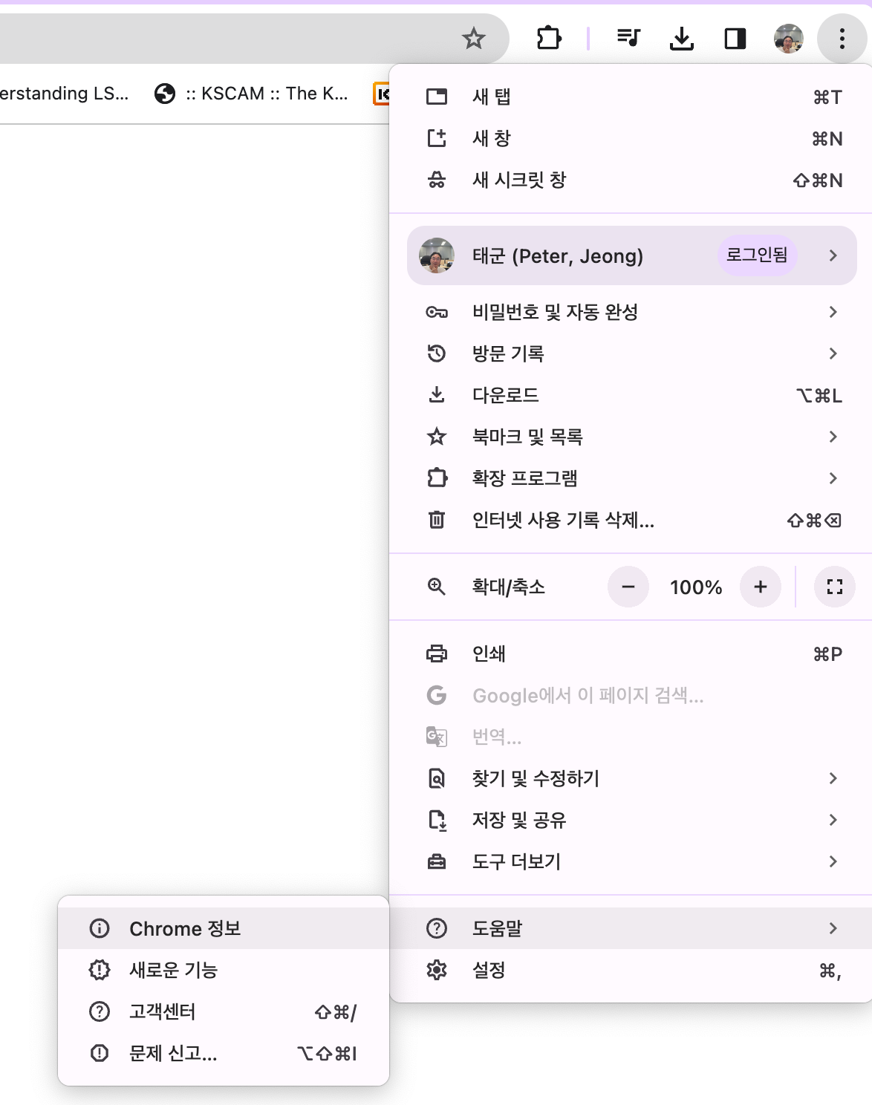
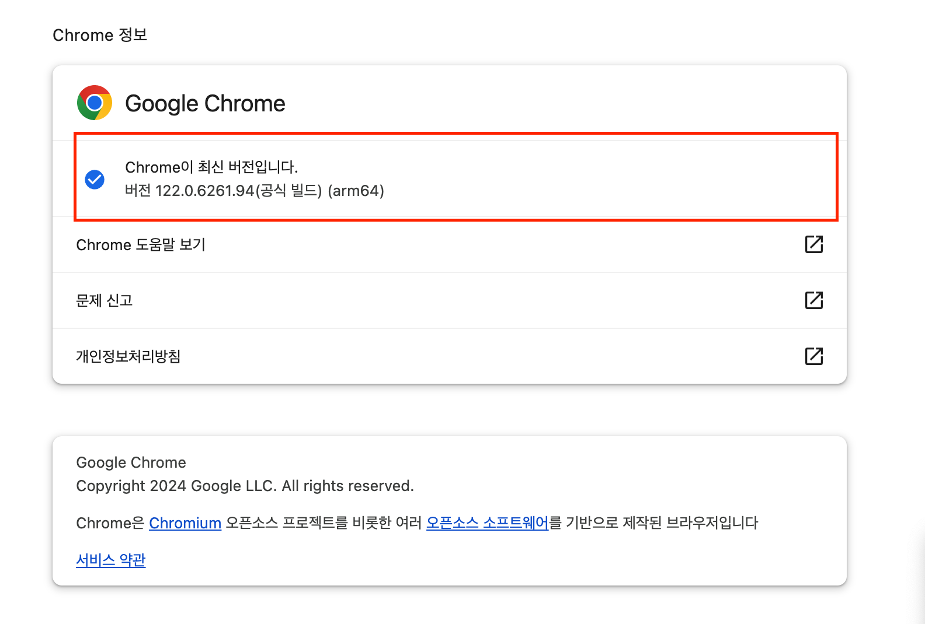
version

Slide 24
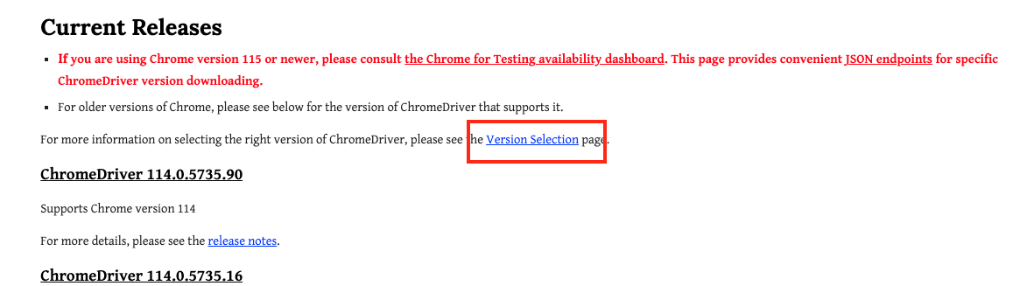
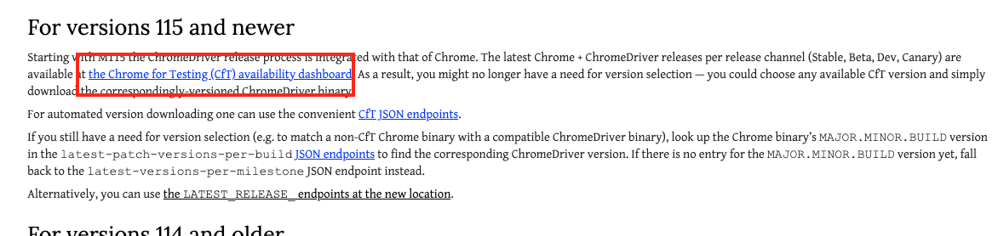
download
https://chromedriver.chromium.org/downloads

Slide 25
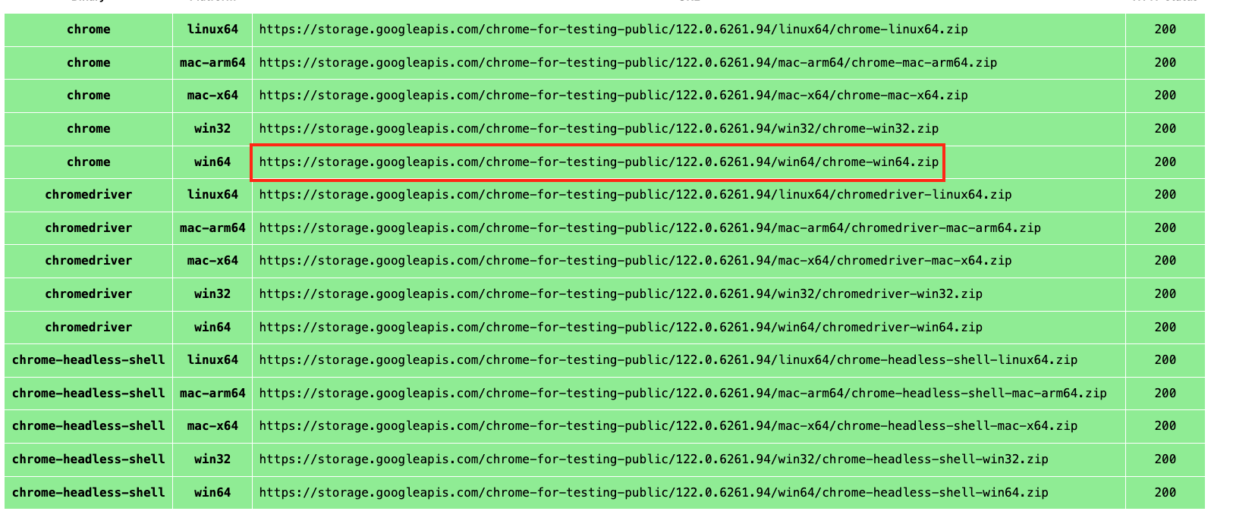

Slide 26
selenium
# pip install selenium
# pip install -U user_agent
# pip install user-agents
# pip install webdriver_manager
from bs4 import BeautifulSoup
from user_agent import generate_user_agent
from user_agents import parse
from selenium import webdriver # 자동화 툴

Slide 27
selenium
from selenium.webdriver.chrome.service import Service
from webdriver_manager.chrome import ChromeDriverManager
from selenium.webdriver.common.by import By
from tqdm import tqdm
import time # 시간 지연
import pandas as pd
import warnings
warnings.filterwarnings('ignore')

Slide 28
selenium
# 서비스 환경별 크롬 드라이브 구분
def chrom_driver() :
userAgent = generate_user_agent()
user_agent = parse(userAgent)
# 옵션 설정
service = Service(executable_path="chromedriver/chrome.exe")
chrome_options = webdriver.ChromeOptions()
chrome_options.add_argument("--disable-extensions")
chrome_options.add_argument("disable-infobars")
chrome_options.page_load_strategy = 'normal'
chrome_options.add_argument('--enable-automation')
chrome_options.add_argument('disable-infobars')
chrome_options.add_argument('disable-gpu')
chrome_options.add_argument('--no-sandbox')

Slide 29
selenium
chrome_options.add_argument('user-agent={}'.format(user_agent))
chrome_options.add_argument('--lang=ko_KR')
chrome_options.add_argument('--ignore-certificate-errors')
chrome_options.add_argument('--allow-insecure-localhost')
chrome_options.add_argument('--allow-running-insecure-content')
chrome_options.add_argument('--disable-notifications')
chrome_options.add_argument('--disable-dev-shm-usage')
chrome_options.add_argument('--disable-browser-side-navigation')
chrome_options.add_argument('--mute-audio')

Slide 30
selenium
# 브라우저 열기
driver
= webdriver.Chrome(service=Service(ChromeDriverManager().install())
, options=chrome_options)
# driver = webdriver.Chrome(service=service, options=chrome_options)
driver.implicitly_wait(3)
return driver

Slide 31
selenium
if __name__ == "__main__":
# coffeeBeen_crawling()
driver = chrom_driver()
for page in range(1, 10):
url = f"https://www.hollys.co.kr/store/korea/korStore2.do?pageNo={page}"
driver.get(url)
time.sleep(10)

Slide 32
selenium
def coffeeBeen_crawling():
url = 'https:/www.coffeebeankorea.com/store/store.asp'
# wd = webdriver.Chrome('webdriverInstallPath/chromedriver.exe')
wd = chrom_driver()
df = pd.DataFrame(columns=['store', 'address', 'phone'])
for i in range(1, 370):
wd.get(url)
try:
wd.execute_script(f'storePops2{i}')
html = wd.page_source
soup = BeautifulSoup(html, 'html.parser')
mName = soup.select('div.stor_txt>h2')
name = mName[0].string

Slide 33
selenium
info = soup.select('div.store_txt>table.store_table>tbody>tr>td')
addresses = list(info[2])
address = addresses[0]
phone = info[3].string
df.loc[i] = [name, address, phone]
except Exception as e:
print(e); continue;
else:
print("success")
df.to_csv("./data/coffen_info.csv")

Slide 34
selenium
from selenium import webdriver
from selenium.webdriver.common.by import By
from selenium.webdriver.common.keys import Keys
from bs4 import BeautifulSoup
from seleniumProject import *
# 웹 드라이버 생성
driver = webdriver.Chrome()
# 로그인 페이지로 이동
driver.get("https://nid.naver.com/nidlogin.login?mode=form&url=https://www.naver.com/")

Slide 35
selenium
# 사용자명과 비밀번호 입력
username = driver.find_element(By.XPATH, '//*[@id="id"]')
password = driver.find_element(By.XPATH, '//*[@id="pw"]')
username.send_keys("kogo1490")
password.send_keys("math1106!@$")
# 로그인 버튼 클릭
login_button = driver.find_element(By.XPATH, '//*[@id="log.login"]')
login_button.click()
html = driver.page_source
soup = BeautifulSoup(html, 'html.parser')
print(soup)

Slide 36
coffeebeankorea 실습

Slide 37
selenium
url = 'https://www.coffeebeankorea.com/member/login.asp'
driver = chrom_driver()
driver.get(url)
time.sleep(random.uniform(1,4))
username = driver.find_element(By.XPATH, """//*[@id="loginForm"]/fieldset/div/div[1]/div[1]/div/p[1]/input""")
password = driver.find_element(By.XPATH, """//*[@id="loginForm"]/fieldset/div/div[1]/div[1]/div/p[2]/input""")
username.send_keys("kogo3039")
time.sleep(random.uniform(1, 4))
password.send_keys("math1106!@#$")
time.sleep(random.uniform(1, 4))

Slide 38
selenium
driver.find_element(By.XPATH, '//*[@id="loginForm"]/fieldset/div/div[1]/div[1]/a').click()
time.sleep(random.uniform(1, 4))
driver.find_element(By.XPATH, """//*[@id="gnb"]/ul/li[3]/a""").click()
time.sleep(random.uniform(1, 4))
driver.execute_script("window.scrollTo(0, document.body.scrollHeight);")
time.sleep(random.uniform(1, 4))
driver.find_element(By.LINK_TEXT, "2").click()
time.sleep(random.uniform(1, 4))

